Slide 1
Robot Jobs
Lab 2 Images

Slide 2
Suggested Role Responsibilities
Builder
Launch VEXcode GO and name the project
Connect the Brain
Watch how to change the parameter in Play Part 1
Edit the project in Play Part 2
Journalist
Configure for Code Base
Build the project in Play Part 1
Start and Stop the project in VEXcode GO
Watch how to change the parameter in Play Part 2

Slide 3
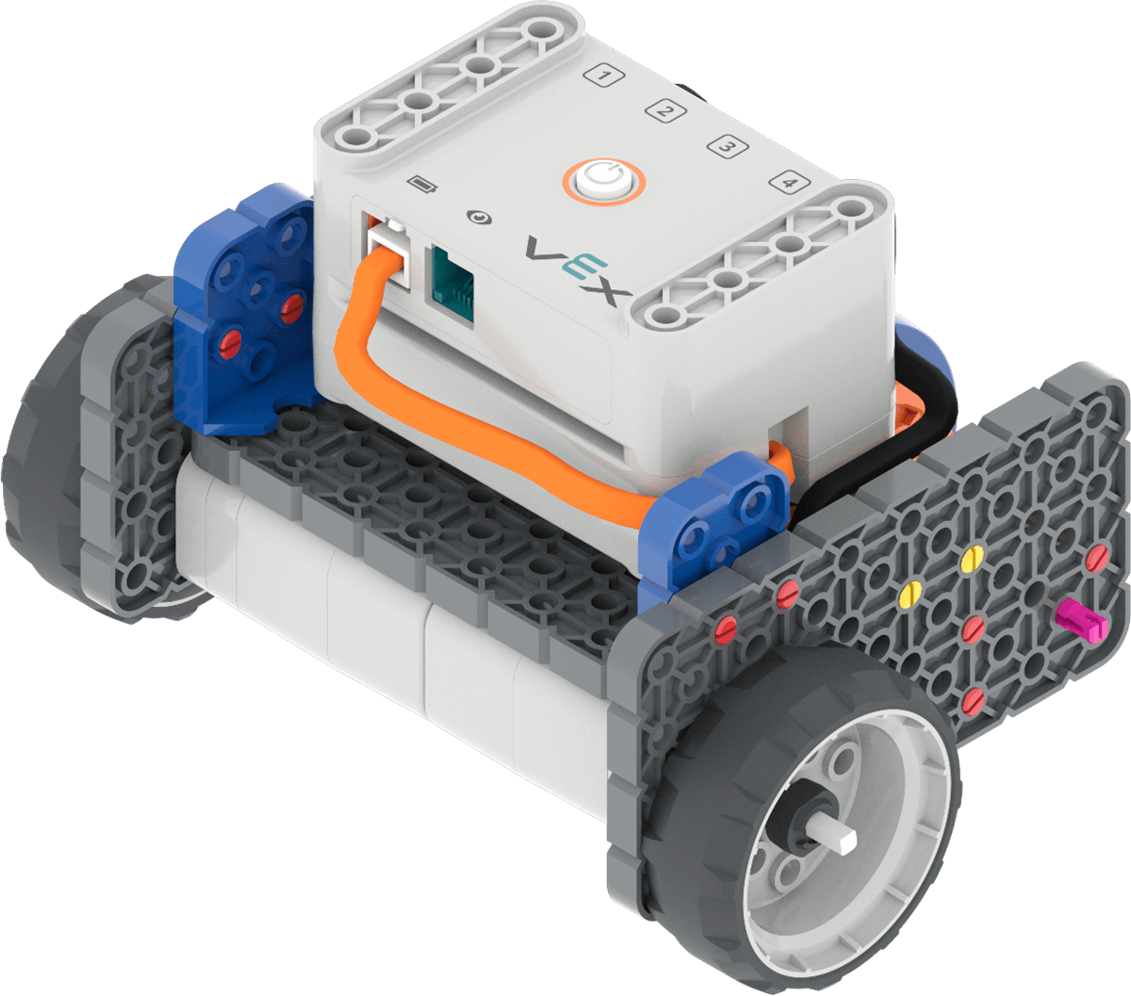
Code Base 2.0

Slide 4
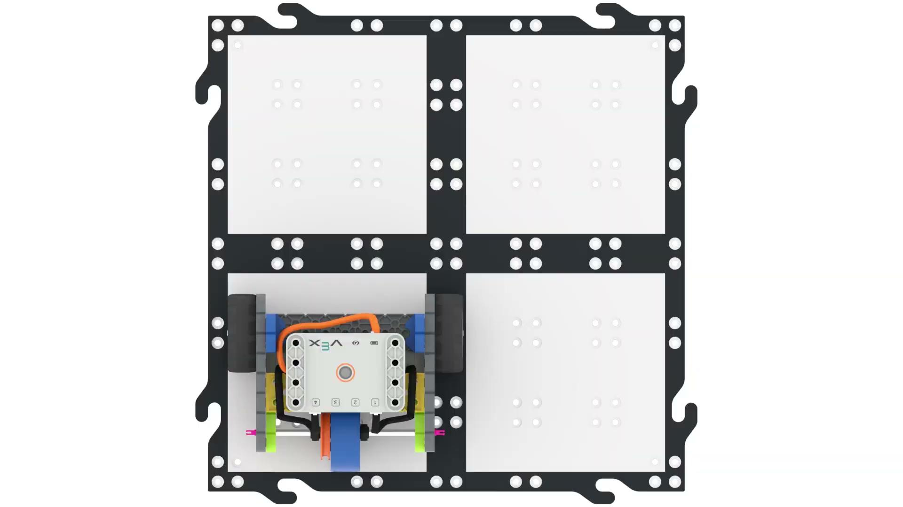
Moving Forward

Slide 5
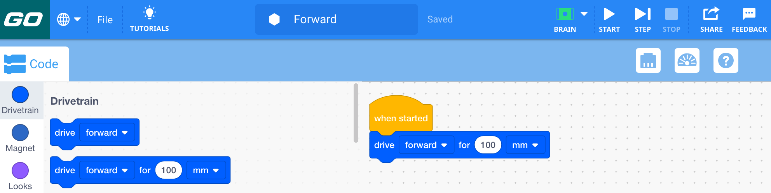
Add the [Drive for] block

Slide 6
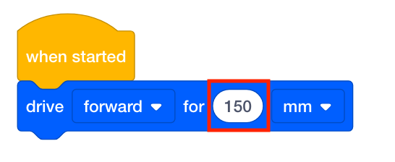
Change the parameter

Slide 7
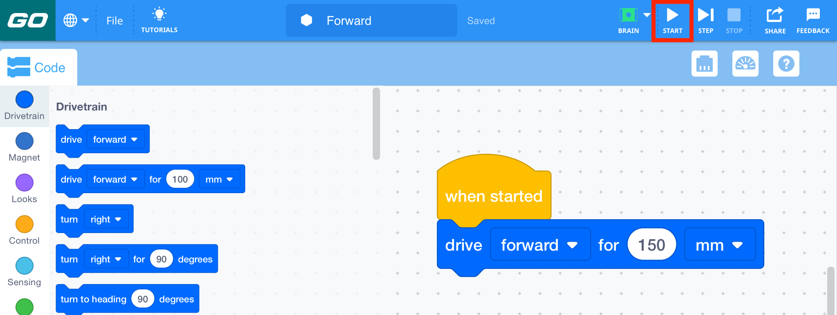
Select the Start button

Slide 8
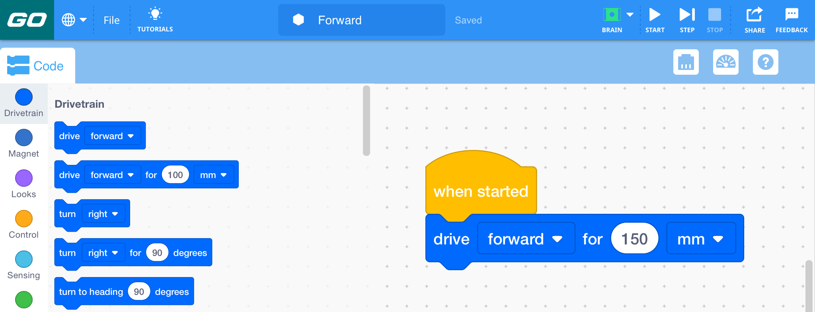
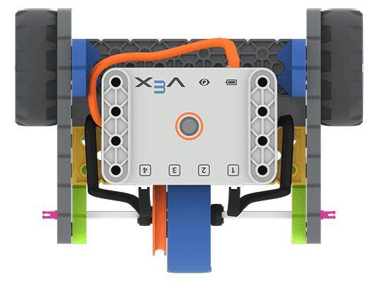
Forward 150mm
150 mm

Slide 9

Discuss the Code Base Robot’s Movement

Slide 10
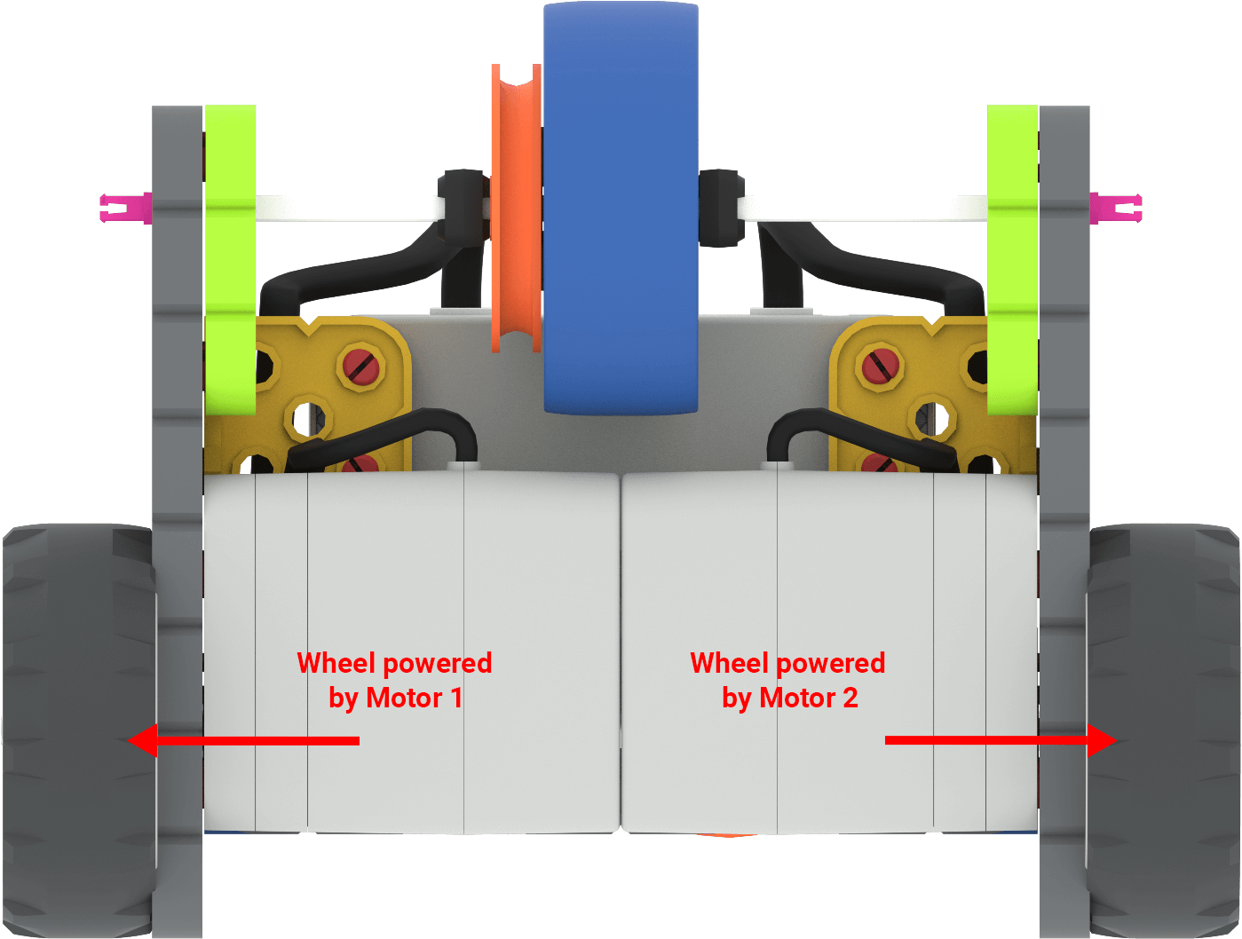
Code Base Drivetrain

Slide 11
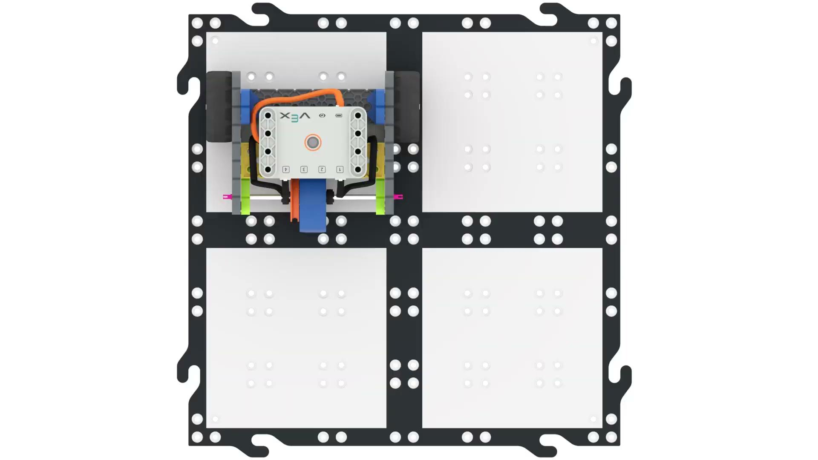
Moving in Reverse

Slide 12
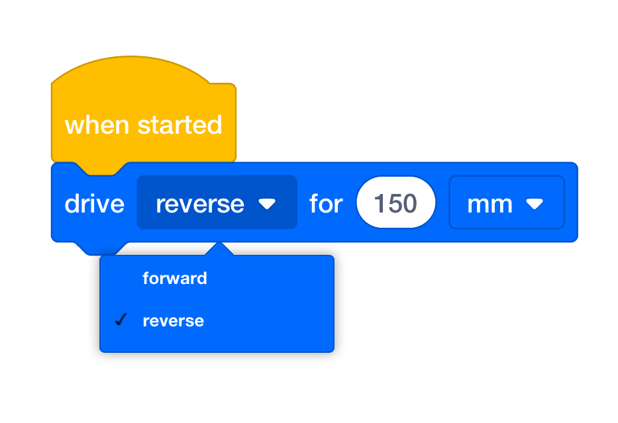
Change the parameter (reverse)

Slide 13
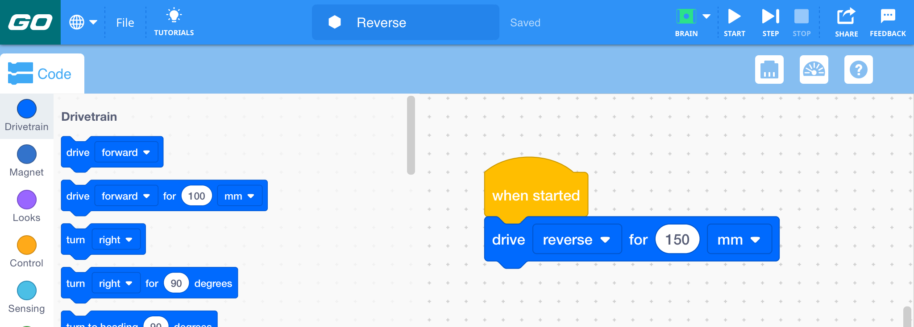
Reverse 150mm
150 mm

Slide 14
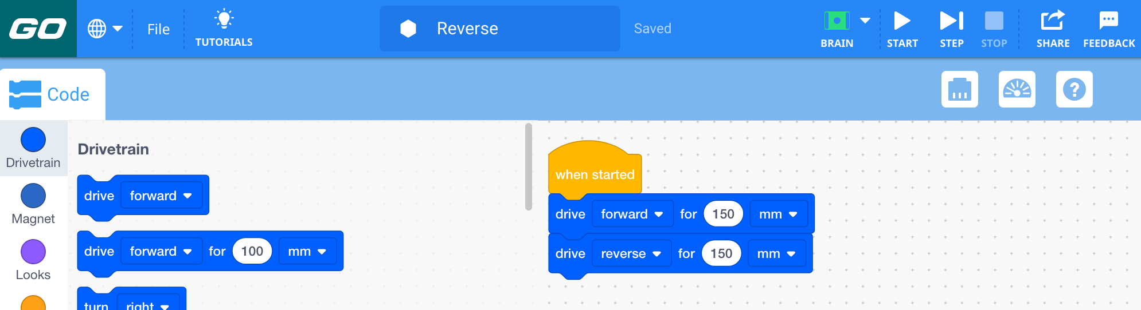
Forward and Reverse

Slide 15
Discuss the Code Base Robot’s Movement

