Slide 1
Robot Jobs
Lab 3 Images

Slide 2
Suggested Role Responsibilities
Builder
Check the Code Base is set up
Connect the Brain and configure for Code Base
Start and Stop the project in VEXcode GO
Build the project in Play Part 2
Journalist
Launch VEXcode GO and name the project
Build the project in Play Part 1
Set up the challenge in Play Part 2
Help plan the project in Play Part 2

Slide 3
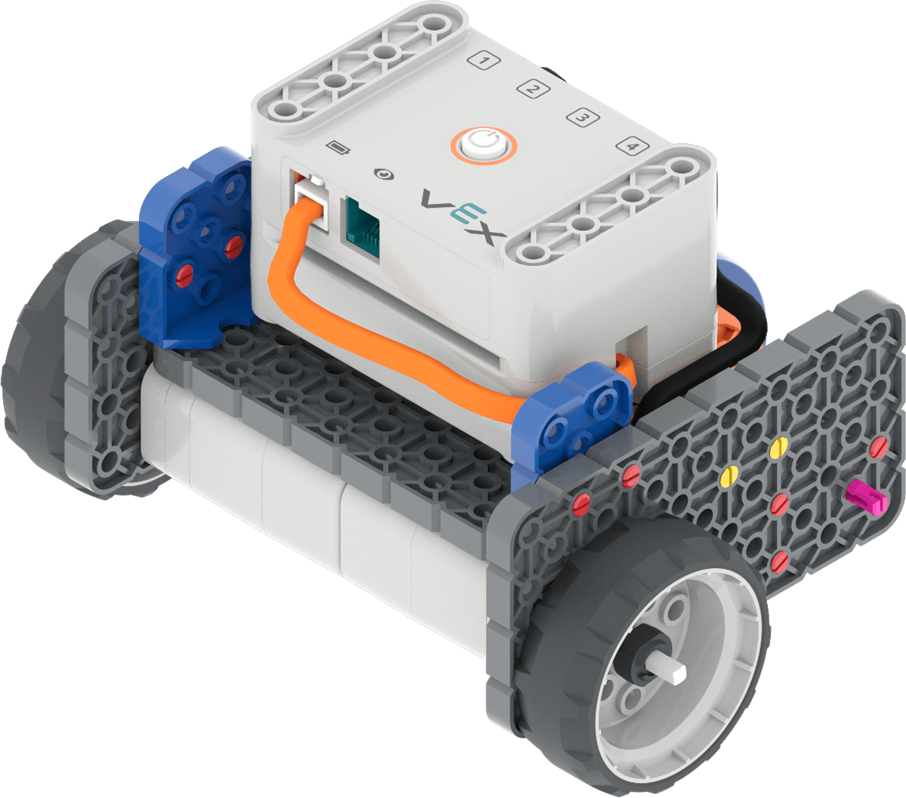
Code Base 2.0

Slide 4
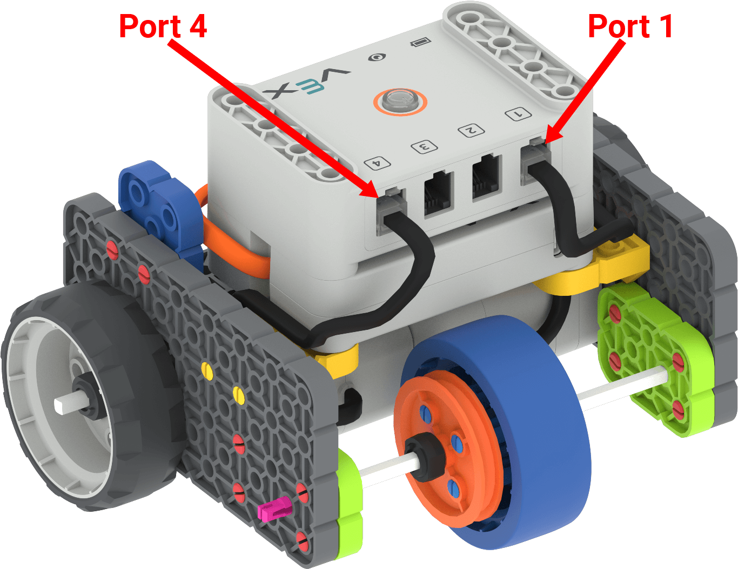
Insert Cables Correctly

Slide 5
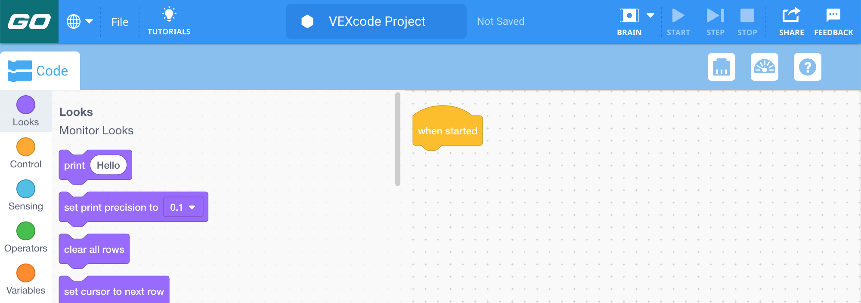
Blank VEXcode GO Project

Slide 6
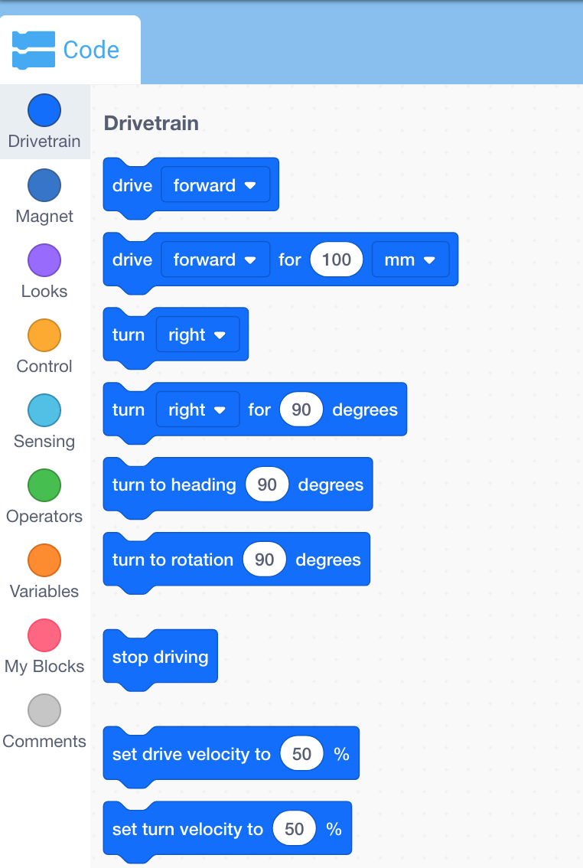
Drivetrain Blocks in the Toolbox

Slide 7
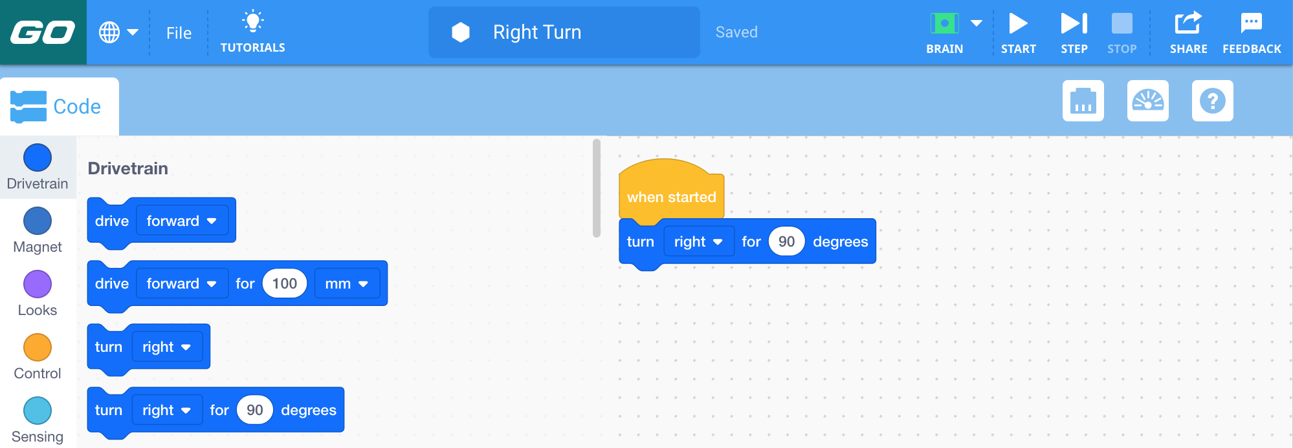
Right Turn Project

Slide 8
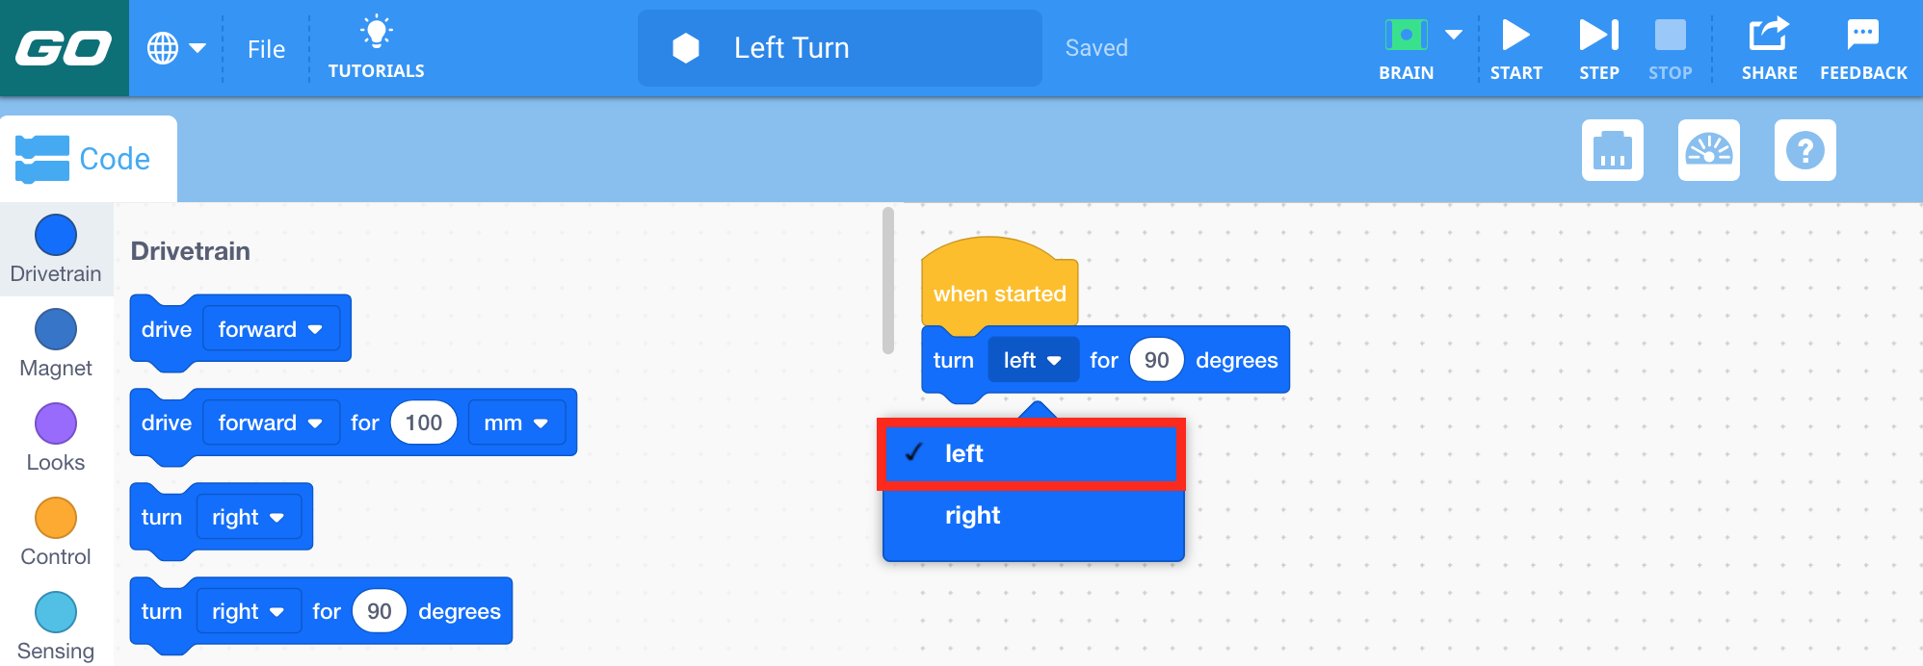
Left Turn Project

Slide 9
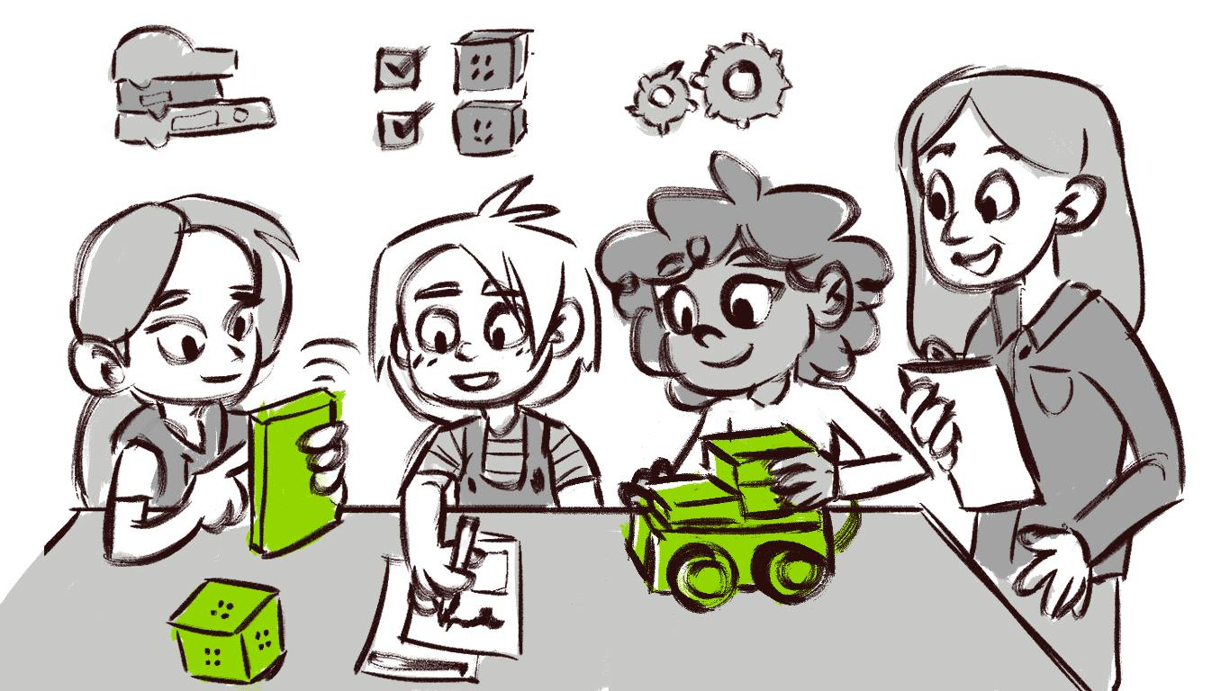
Group Discussions

Slide 10
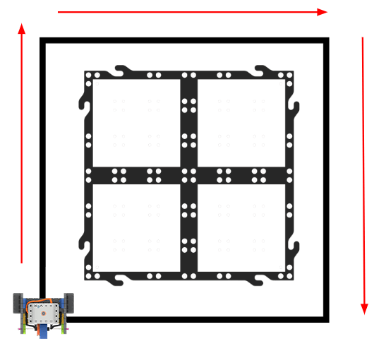
Code Base in the Warehouse Challenge

Slide 11
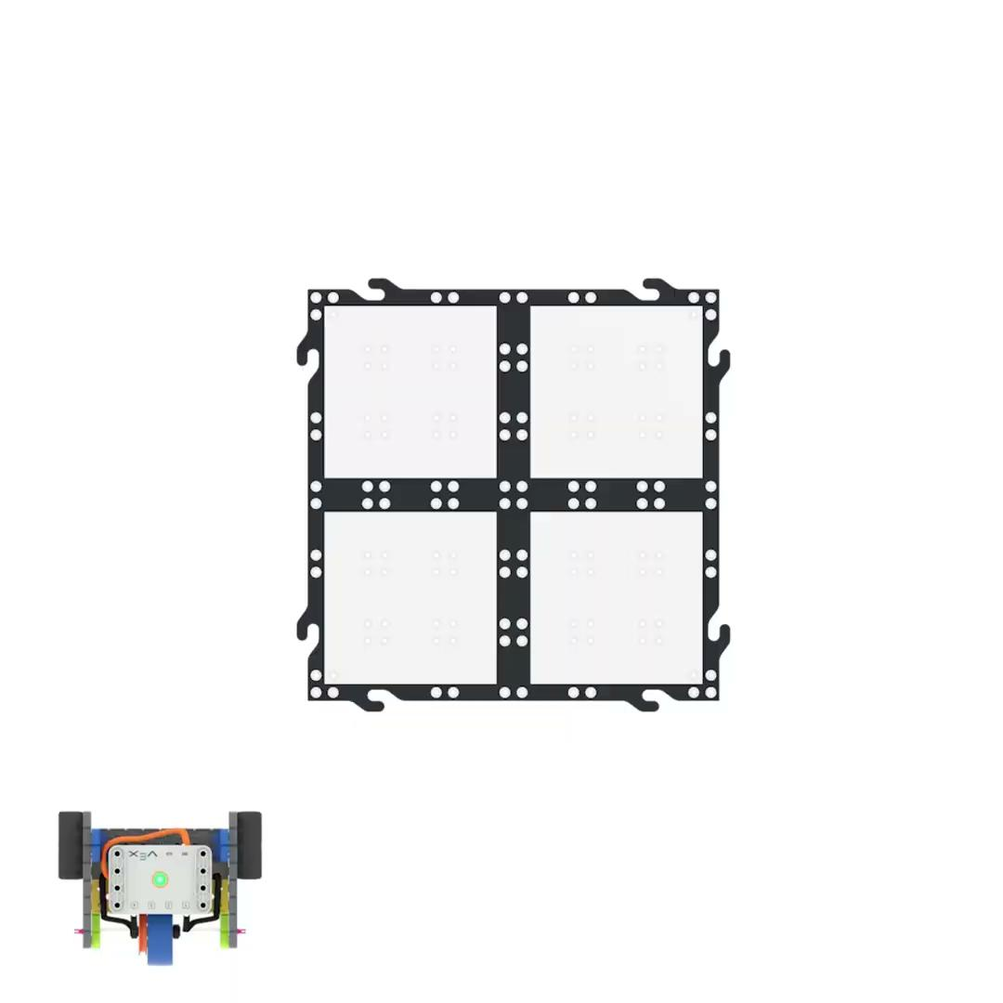
Making a square

Slide 12
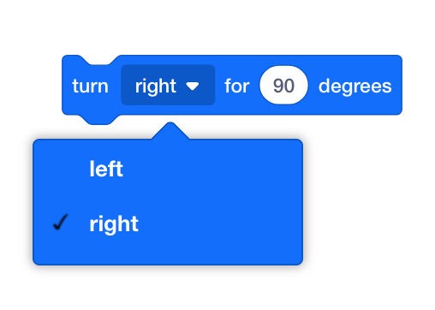
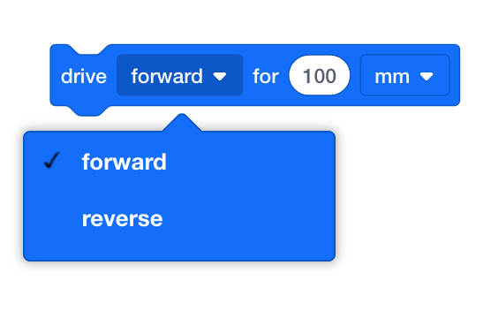

VEXcode GO Blocks Used
{When started}
[Drive for]
[Turn for]

