Slide 1
Robot Jobs
Lab 4 Images

Slide 2
Suggested Role Responsibilities
Builder
Check the Code Base is set up
Connect the Brain
Help design the project plan
Start and Stop the project in VEXcode GO
Deconstruct the Code Base
Journalist
Launch VEXcode GO and name the project
Write/draw the project plan
Configure for Code Base
Build the project in Play Part 2
Sort pieces into Kits

Slide 3
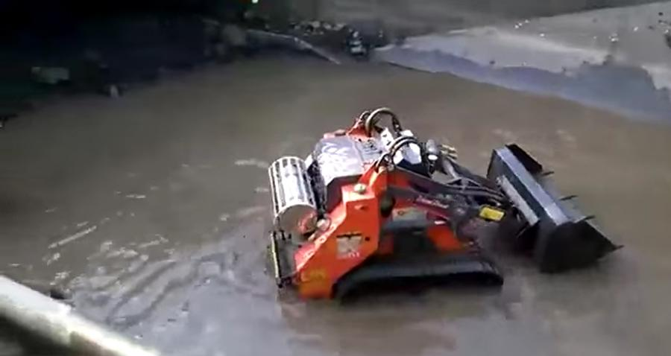
Dirty Job 1 - Sewer Robot
Job: Sewer Cleaning and Mapping
Sewers are dirty! It is unhealthy for people to be in the sewers.
Sewer robots are designed to fit into small spaces where people cannot fit.
Natural Resources Wales / CC BY (https://creativecommons.org/licenses/by/3.0)

Slide 4
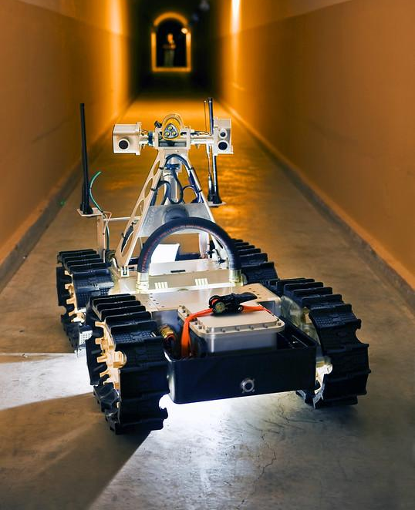
Dirty Job 2 - Mining Robot
Job: Mine Exploration
Mines are dirty (filled with dust and mud) and dangerous.
Mining robots are used to map flooded passages or analyze rocks and minerals.

Slide 5
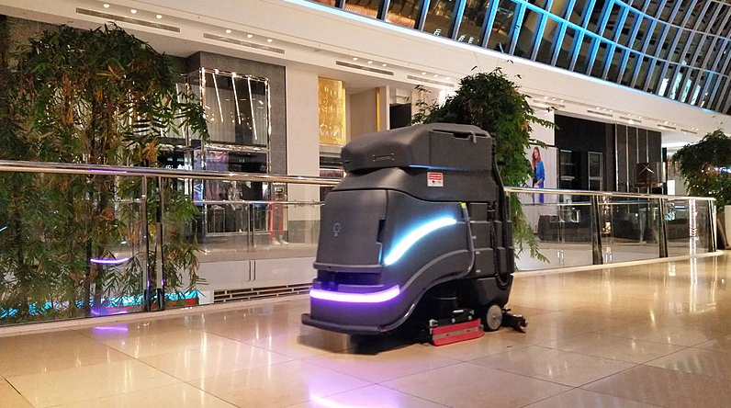
Dull Job 1 - Cleaning Robot
Job: Cleaning Floors
Scrubbing floors takes time and can be boring.
Cleaning robots come in all sizes! Small household robots to large robots cleaning floors in a mall.
MrVollbrecht / CC BY-SA (https://creativecommons.org/licenses/by-sa/4.0)

Slide 6
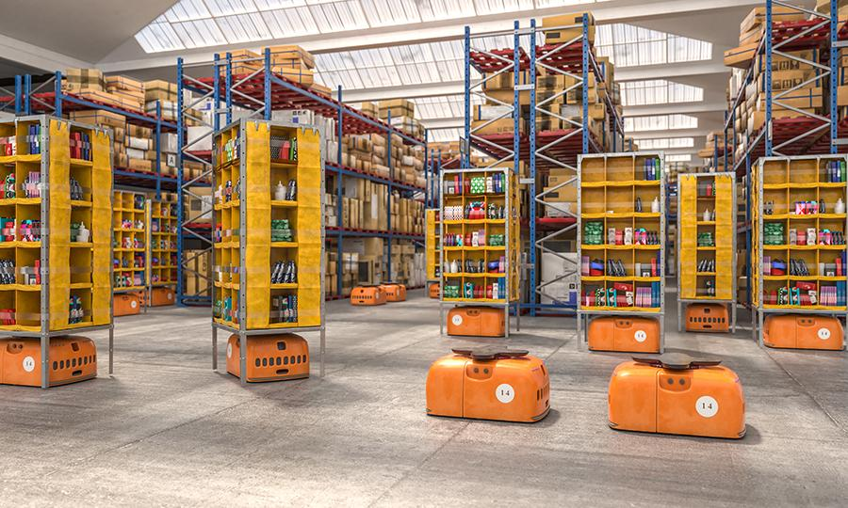
Dull Job 2 - Warehouse Robot
Job: Warehouse
Moving around a warehouse to grab things is boring. Robots help to make retrieving items faster.
Warehouse robots are great at fitting into small places so they can find the right items.

Slide 7
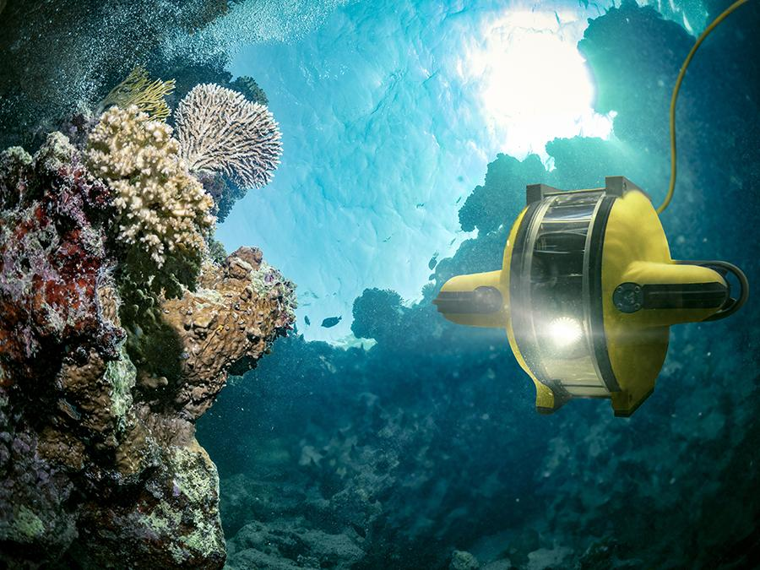
Dangerous Job 1 - Photographing Robot
Job: Photographing animals
People can’t crawl up to a lion and take its picture. But, a robot can be programmed to drive much closer to an animal and take photos.
Photographic robots also do jobs underwater with deep-sea creatures!

Slide 8
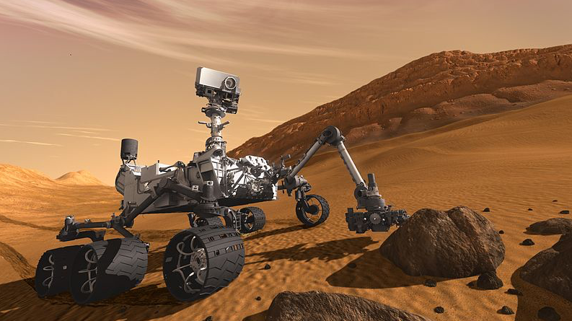
Dangerous Job 2 - Space Robots
Job: Mars Rover
Travelling and collecting data in on other planets is dangerous and sometimes impossible for humans.
Robots hardware that allows them to collect and test the air, water and soil.

Slide 9
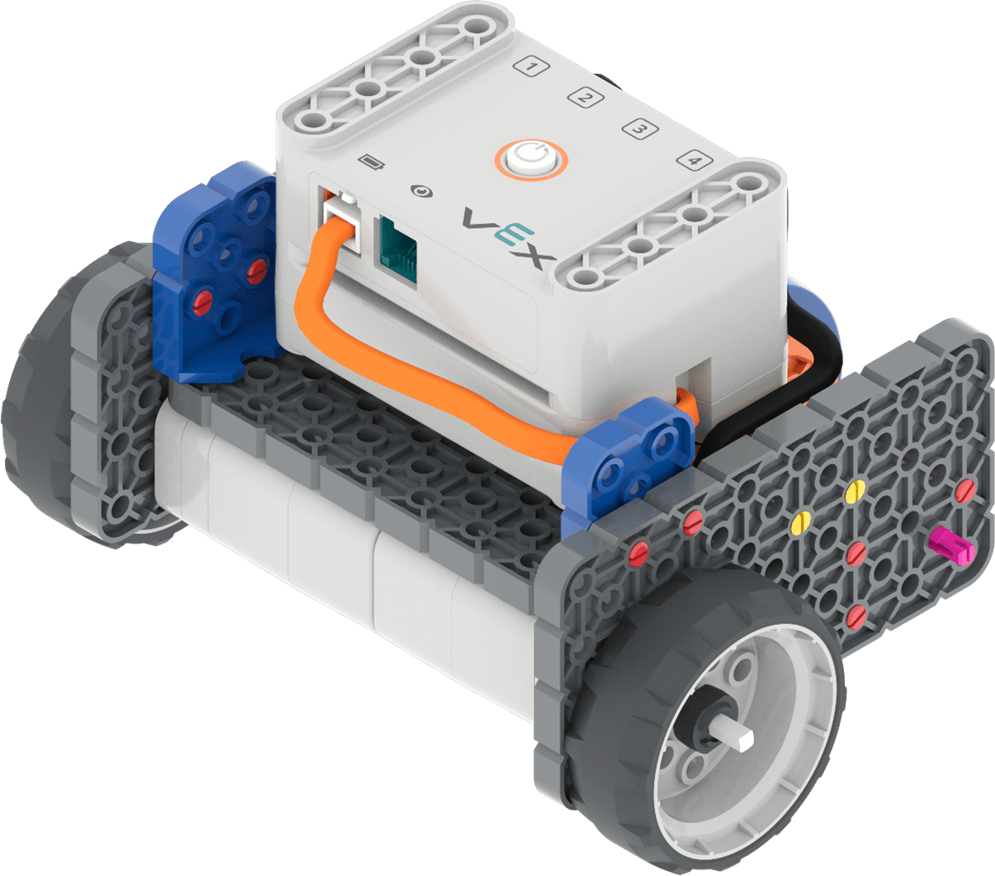
Code Base 2.0

Slide 10

Project Plan

Slide 11
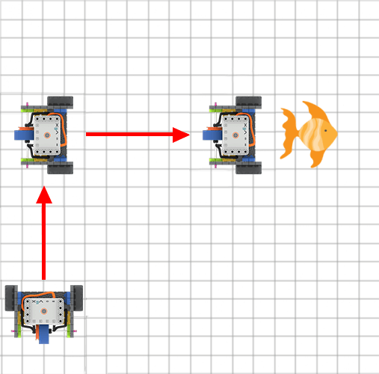
Blueprint Sketch

Slide 12

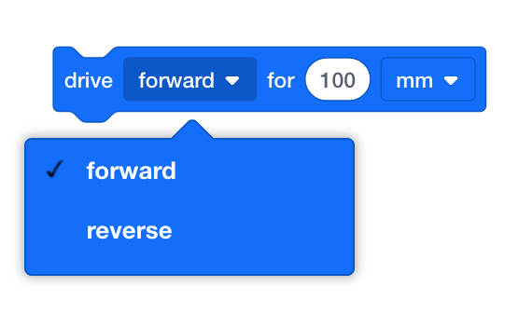
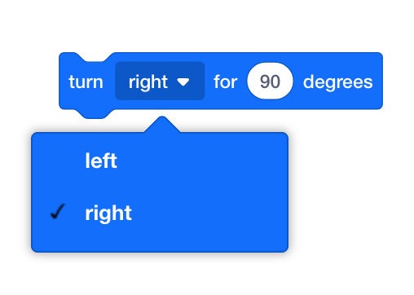
Using VEXcode GO Blocks
{When started}
[Drive for]
[Turn for]

Slide 13
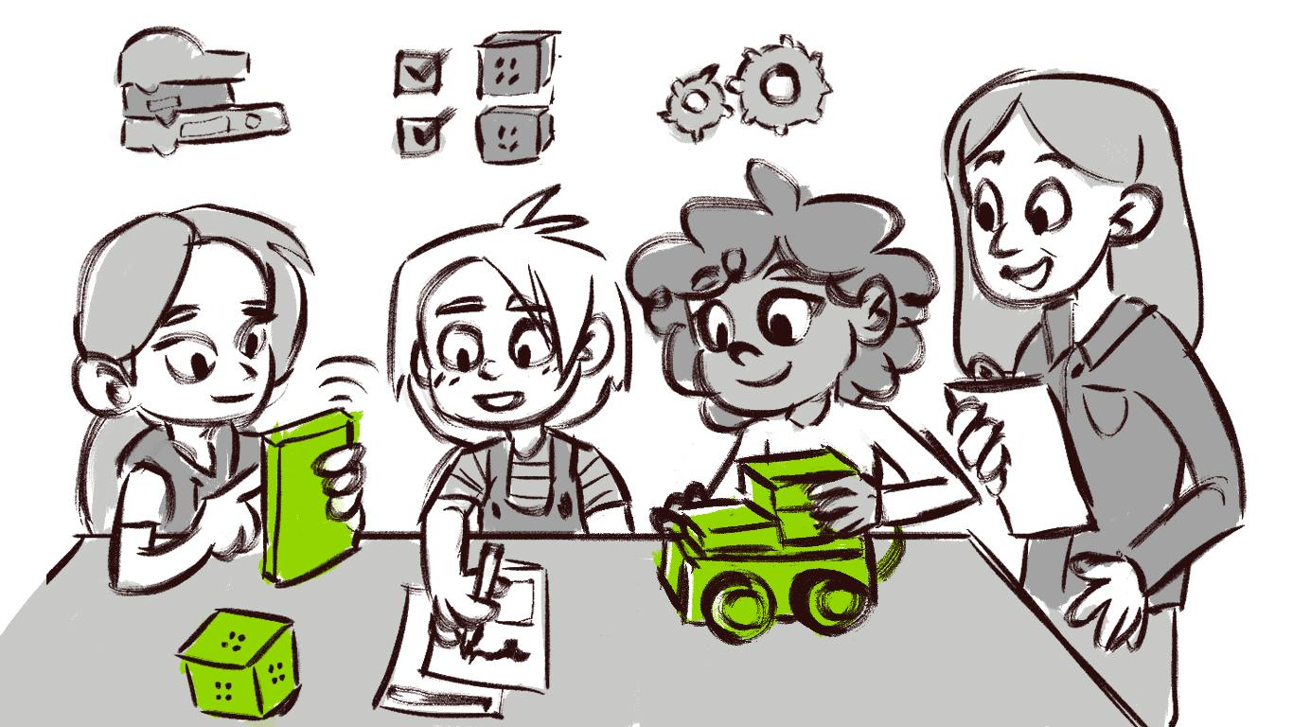
Group Discussions

